Slide 1
CSE408
Optimal binary search tree and
Knapsack problem
Lecture # 23

Slide 2
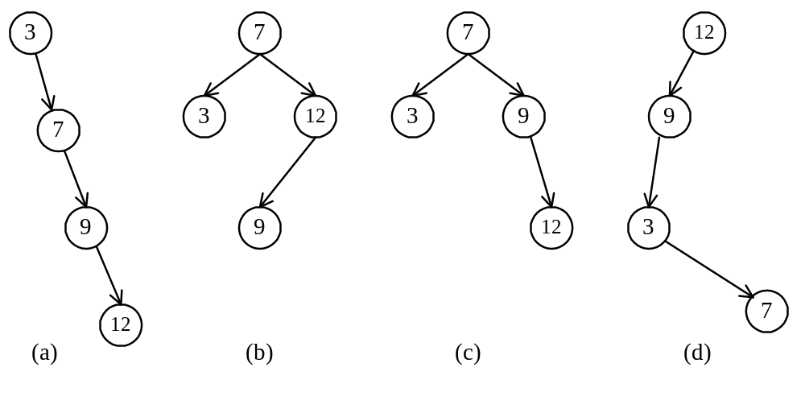
Optimal binary search trees
e.g. binary search trees for 3, 7, 9, 12;
8 -<number>

Slide 3
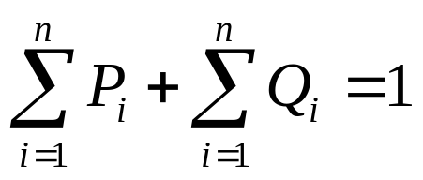
Optimal binary search trees
n identifiers : a₁ <a₂ <a₃ <…< a_{n}
P_{i}, 1≤i≤n : the probability that a_{i} is searched.
Q_{i}, 0≤i≤n : the probability that x is searched
where a_{i} < x < a_{i+1} (a₀=-∞, a_{n+1}=∞).
8 -<number>

Slide 4
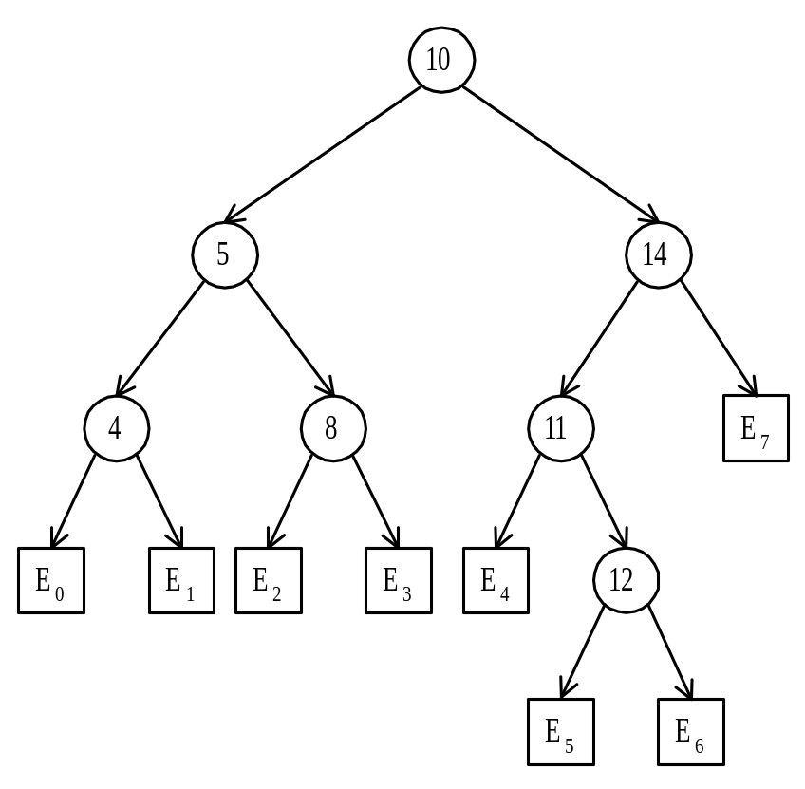
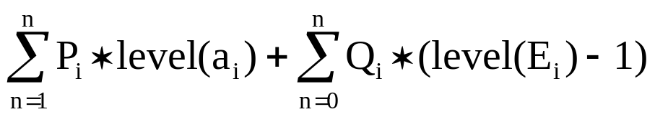
Identifiers : 4, 5, 8, 10, 11, 12, 14
Internal node : successful search, P_{i}
External node : unsuccessful search, Q_{i}
The expected cost of a binary tree:
The level of the root : 1
8 -<number>

Slide 5
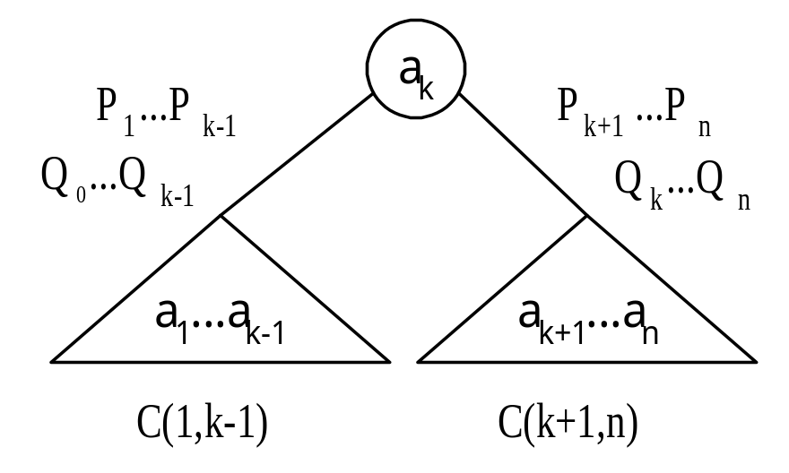
The dynamic programming approach
Let C(i, j) denote the cost of an optimal binary search tree containing a_{i},…,a_{j} .
The cost of the optimal binary search tree with a_{k} as its root :
8 -<number>

Slide 6
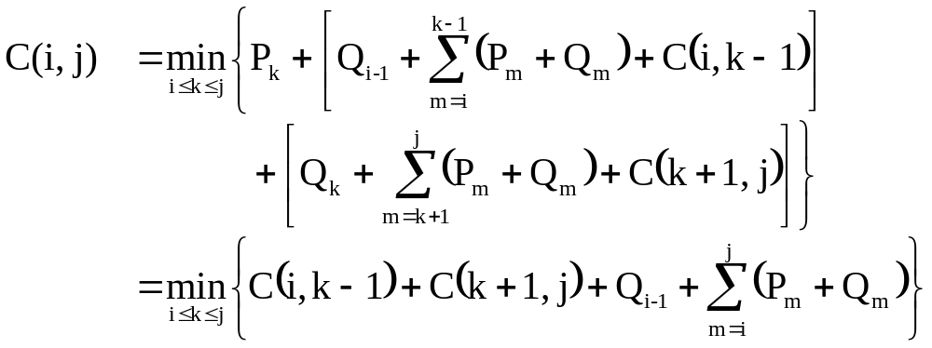
General formula
8 -<number>

Slide 7
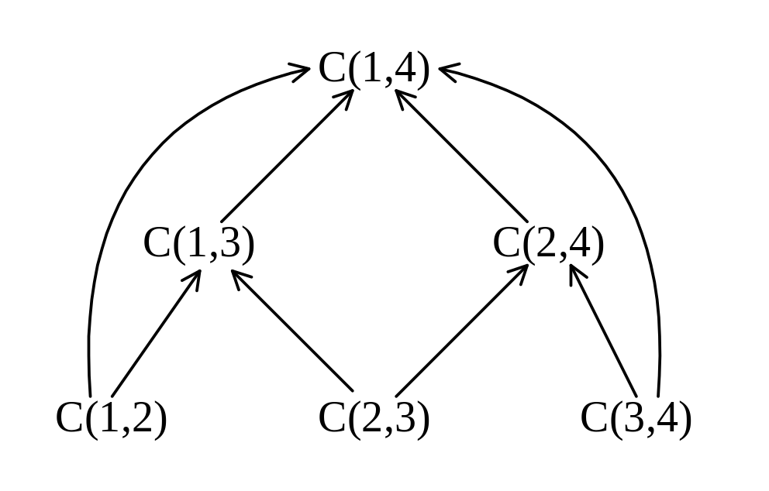
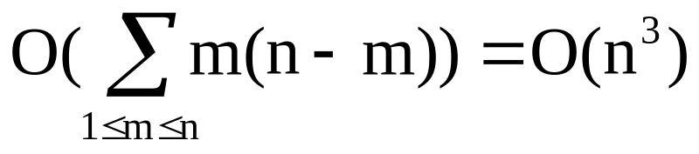
Computation relationships of sub trees
e.g. n=4
Time complexity : O(n³)
when j-i=m, there are (n-m) C(i, j)’s to compute.
Each C(i, j) with j-i=m can be computed in O(m) time.
8 -<number>

Slide 8
Knapsack problem
There are two versions of the problem:
  “0-1 knapsack problem”
    Items are indivisible; you either take an item or not. Some special instances can be solved with dynamic programming
  “Fractional knapsack problem”
    Items are divisible: you can take any fraction of an item

Slide 9
0-1 Knapsack problem
Given a knapsack with maximum capacity W, and a set S consisting of n items
Each item i has some weight w_{i} and benefit value b_{i} (all w_{i} and W are integer values)
Problem: How to pack the knapsack to achieve maximum total value of packed items?

Slide 10
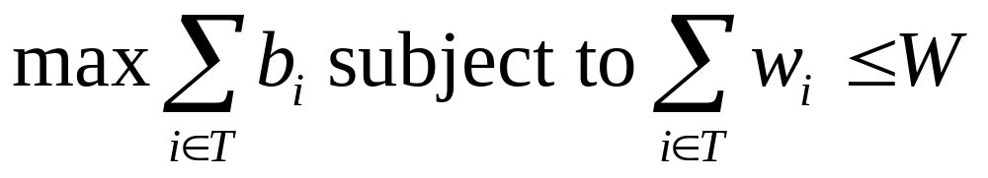
0-1 Knapsack problem
Problem, in other words, is to find
The problem is called a “0-1” problem, because each item must be entirely accepted or rejected.

Slide 11
0-1 Knapsack problem: brute-force approach
Let’s first solve this problem with a straightforward algorithm
Since there are n items, there are 2^{n} possible combinations of items.
We go through all combinations and find the one with maximum value and with total weight less or equal to W
Running time will be O(2^{n})

Slide 12
0-1 Knapsack problem: dynamic programming pproach
We can do better with an algorithm based on dynamic programming
We need to carefully identify the subproblems

Slide 13
Defining a Subproblem
Given a knapsack with maximum capacity W, and a set S consisting of n items
Each item i has some weight w_{i} and benefit value b_{i} (all w_{i} and W are integer values)
Problem: How to pack the knapsack to achieve maximum total value of packed items?

Slide 14
Defining a Sub problem
We can do better with an algorithm based on dynamic programming
We need to carefully identify the subproblems
Let’s try this:
If items are labeled 1..n, then a subproblem
would be to find an optimal solution for
S_{k} = {items labeled 1, 2, .. k}

Slide 15


